Slide 1

Lesson Recapper
AI CONSULTING & INTEGRATION · WEEK 2 PROJECT
Upload your class notes. Get a podcast episode back.
Armin · Fritz · Sandra
Notes:
About 20 seconds. Introduce the team and the one-line idea: we built an app that turns class notes into a podcast episode you can listen to. Then go straight to the problem.

Slide 2



Class notes pile up. Nobody rereads them.
THE PROBLEM
Too much material
No time to review
Ears are free
Long notes and PDFs, new ones every week.
Rereading feels like work, so it gets skipped.
Commutes, walks, the gym: perfect time to listen.
Notes:
About 20 seconds. We all have more notes than we will ever reread. But we do have time to listen: on the way to class, on a walk. So the idea: turn the notes into a short podcast that explains the content, not just reads it out.

Slide 3

One job per file
HOW IT WORKS
data_processor
llm_processor
tts_generator
main
Clean
Write
Record
Play
Reads TXT, PDF or an article URL and cleans the text
gpt-4o-mini turns the notes into a teaching script
tts-1 reads the script aloud and saves an mp3
Gradio app: pick a source and length, listen, download
Each teammate owned one module, so we could build in parallel. A short episode takes about 15 to 25 seconds from upload to audio.
Notes:
About 35 seconds. Walk left to right. data_processor reads the upload, a TXT or PDF file or a web article from a URL, and cleans it. llm_processor sends it to gpt-4o-mini with our system prompt and gets a script back. tts_generator turns that script into speech with the tts-1 voice. main.py is the Gradio app that connects all three. Point: one job per file meant one owner per file.

Slide 4








What the app can do
FEATURES
PDF and TXT
Article URLs
Text cleaning
Length selection
Upload class notes; the text of every page is extracted.
Paste a link; only the article is kept, menus and ads are dropped.
Fixes ligatures, odd characters and messy spacing from PDFs.
Short, Medium or Long: about 3, 15 or 30 minutes.
Part-by-part
Audio chunking
Save + download
Clear errors
Long episodes: outline first, then each part, so nothing stops early.
Pieces under 4,000 characters, recorded 4 at a time, joined into one mp3.
Every episode gets its own mp3 and script. The script is kept even if audio fails.
Scanned PDF, paywall, timeout: the app says what went wrong.
Notes:
About 40 seconds. Do not read every card; group them. Input: PDF, TXT, or an article URL, where only the article text is kept, and everything gets cleaned. Output length: Short, Medium or Long, and long episodes are written part by part from an outline. The two dark cards are the engineering highlights: the length selection and the audio chunking, because the voice model only takes 4,000 characters at a time, so we split the script, record four pieces in parallel and join them into one mp3. Finally: every episode is saved with its own name and a download button, and clear error messages when a PDF is scanned or a website is behind a paywall.

Slide 5
A prompt written for our class
THE SCRIPT ENGINE
Meet Sam, the host
You pick the length
Instructor and AI consultant, talks to "you"
Explains the why, keeps the real terms
Links every idea to consulting work
Skips PDF clutter, never invents facts
Length | Words | Parts
Short, 3 min | 450 | 1
Medium, 15 min | 2,250 | 4
Long, 30 min | 4,500 | 8
Long episodes are planned as an outline, then written part by part. Test run: medium gave 2,258 words and 14.6 minutes of audio.
Notes:
About 35 seconds. The quality comes from the system prompt. One host, Sam, who talks to you like a good instructor who has also done consulting. Rules: plain words but keep the real terminology, always explain why, connect it to client work, ignore PDF layout junk and do not invent facts. Second feature: the length selector. The model stops early on very long texts, so for medium and long we first plan an outline and then write each part separately.

Slide 6
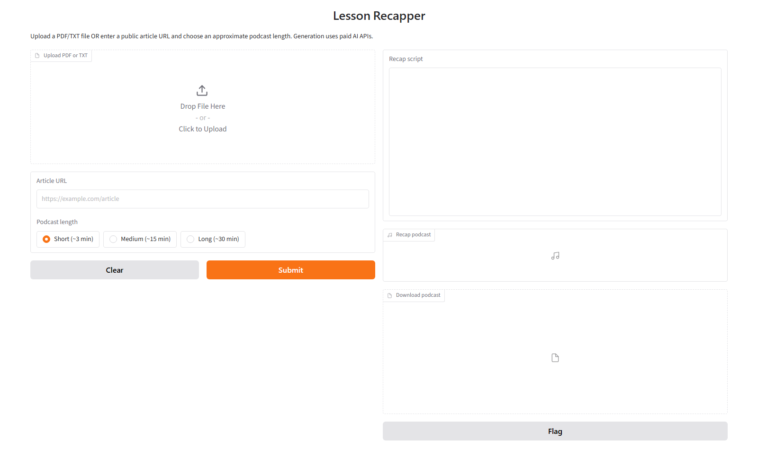
Let's make an episode
LIVE DEMO · 2 MINUTES
1
Upload notes or paste an article URL
2
Pick Short, Medium or Long
3
Listen, read along, download
Notes:
About 2 minutes. Before the talk: start the app with python src/main.py and open http://127.0.0.1:7860 in the browser. During the demo: upload the notes file (or paste an article URL), keep Short so it finishes in about 15 to 25 seconds, click Submit. While it generates, point at the length options and the article URL field. Then play 20 to 30 seconds of audio, scroll the script, and show the download button. Every episode is saved with its own name in outputs/. Backup if the Wi-Fi or API is slow: this screenshot, plus an already generated episode open in a second tab.

Slide 7
Own a module, merge through pull requests
TEAMWORK WITH GIT
3
4
9
teammates, one branch each
modules with one job each
pull requests merged into main
-> Are we all on the same page?
Notes:
About 30 seconds. Each of us had a branch and a module. Work reached main only through pull requests. Our first two PRs both changed .gitignore and requirements.txt and collided, which taught us to pull main into our branch before starting and before opening a PR. At the end, three features landed in main.py in the same week: the length selector, the article URL input and the environment fix. We merged them one at a time and tested the app after each merge.

Slide 8

Trial. Error. Merge.
KEY TAKEAWAY
Each of us used AI to adapt code on our own branch. Bringing those versions together took extra coordination and caused some confusion. Now we're all on the same branch.
One branch per task
Pull main before every PR
Merge one at a time, then test
Notes:
About 20 seconds. Say the slogan, pause, then the story: we learned Git as a team the hard way, by trial and error. Each of us used AI to compare and adapt our code, but we were working on different branches. Bringing those versions together took extra coordination and sometimes caused confusion, so our workflow wasn't always efficient. Optional joke with a smile: our AI assistants wrote most of the code, we mostly carried their merge conflicts between laptops. What fixed it was boring Git discipline: one branch per task, pull main before every pull request, merge one at a time and test after each merge. Then: thank you, questions?

